Slide 1

TOPIC:
What is computer science?
Learning Objective:
IWBAT define computer science and design my first computer program.
Standard:
7-8.CT.4
Notes:
7-8.CT.4 Write a program using functions or procedures whose names or other documentation convey their purpose within the larger task.

Slide 2

Warm Up
What does Computer Science mean to you?
Notes:
Have students answer this question in their notebooks.
Share out once timer ends.
They may dance if finished early.

Slide 3

What is Coding?
Notes:
Play video from Flocabulary.
Have students take notes on what stood out to them.
Turn and Talk: Share out afterwards.

Slide 4

Get Out!
Get me, your teacher, out of class through the door.
Notes:
Have your students try to use explicit instructions to get you out of the door.
Be as silly as possible.
If no students are able to explicitly instruct you, you may show them.

Slide 5
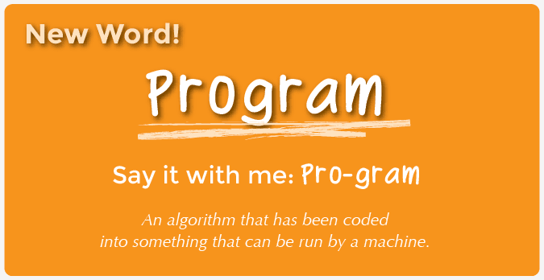
Notes:
“What you did just now was programming your teacher”
Have students write down word and definition.
Cold call student to read definition
“Now it is your turn to create a program”

Slide 6

Move it, Move It!
Directions for Class:
Decide who will be the Walking Machine and who will be the Controller.
Have the Controller set up a grid on the floor made up of pieces of paper as shown on one of the Move It Maps, except with the smiley face upside down, facing the ground.
The Walking Machine will start by standing on the page with the compass rose.
The Controller will then lead the Walking Machine step-by-step through the paper maze that they created, using the provided arm signals.
When the Controller gives the signal to “STOP,” the Walking Machine will flip over the page that they are on. If that page is a smiley face, then the maze was a success!
Notes:
Unplugged Activity:
Source: https://code.org/curriculum/course1/2/Teacher
Give students 20 minutes
Have students follow instructions in the activity packet.

Slide 7

Wrap Up
In the game we just played, who do you suppose was more like a programmer, and who was more like a computer?
What were the four directions on the compass rose?
What tricks can we use to remember North, South, East and West?
How could we have given instructions without using our arms?
What was your favorite part about that game?
Notes:
Unplugged Activity:
Source: https://code.org/curriculum/course1/2/Teacher
Have a discussion about the provided questions

Slide 8
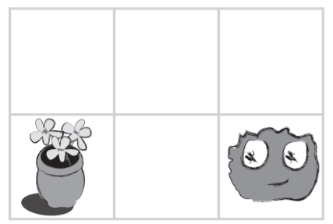
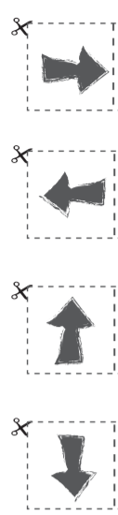
Exit Ticket
Directions for Class:
Cut and glue the correct arrows onto the worksheet.
Submit when completed.
Notes:
Unplugged Activity:
Source: https://code.org/curriculum/course1/2/Teacher
Give students 10 minutes
Hand out the worksheet titled "Move the Flurbs 2" and allow students to complete the activity independently after the instructions have been well explained.

